Slide 1

COMP7500 Advanced Operating Systems
Shared-Memory Systems
Dr. Xiao Qin
Auburn University http://www.eng.auburn.edu/~xqin
xqin@auburn.edu
Notes:
2020Spring: No time to cover project 1 introduction
Sides 1-16: 50 minutes (Handout Updated)
2019Spring: Project 1: gdb comments. 5 Minutes
03-Shared memory Systems: 45 Minutes, Slides 1-13
Slides 14-15 TBC.

Slide 2

Review: IPC Model 1 - Shared Memory
Notes:
Shared Memory

Slide 3

Review: IPC Model 2 - Message Passing
Notes:
Shared Memory

Slide 4
Exercise 1. Shared Memory vs. Message Passing
(1.1) Which one is shared Memory and which one is message passing?
(1.2) Which one do you prefer and why?
Notes:
Which one is shared memory, which one is message passing?

Slide 5
Exercise 2 (Menti): Suppose two processes are exchange a small amount of data, which interprocess communication model will you choose? Why?
A) Shared Memory
B) Shared Buffer
C) Message Passing
D) None of the above

Slide 6
Review: Which interprocess communication model is faster than its counterpart? Assumption: message-passing systems are implemented using system calls; shared-memory systems are implemented in the OS kernel.
A) Message Passing is faster B) Shared Memory is faster
C) Shared Message is faster D) Two models are both fast

Slide 7
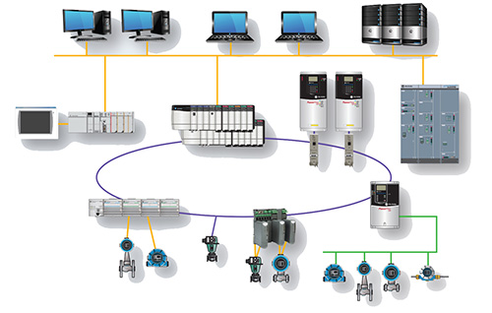
Review: Which interprocess communication model is easier to implement in a distributed system?
Shared Memory is easier
Message Passing is faster
Message Passing is easier
Two models are equal

Slide 8
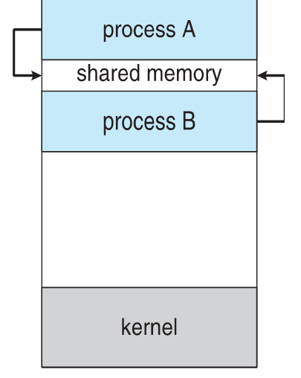
Exercise 5 (Menti): Where should the shared memory region reside?
Process A
Process B
Randomly pick process A or B
The process that creates the shared memory region

Slide 9
A Problem: Can you propose a solution?
The operating system prevents one process from accessing another process’s memory.
Basic Idea: Two process agree to remove such a restriction.
How to implementation this idea?

Slide 10
Sample Code
#include <iostream>
#include <sys/ipc.h>
#include <sys/shm.h>
#include <stdio.h>
using namespace std;

Slide 14
SHARED MEMORY FOR WRITER PROCESS
Notes:
https://www.geeksforgeeks.org/ipc-shared-memory/

Slide 15
SHARED MEMORY FOR READER PROCESS
Notes:
https://www.geeksforgeeks.org/ipc-shared-memory/

Slide 16
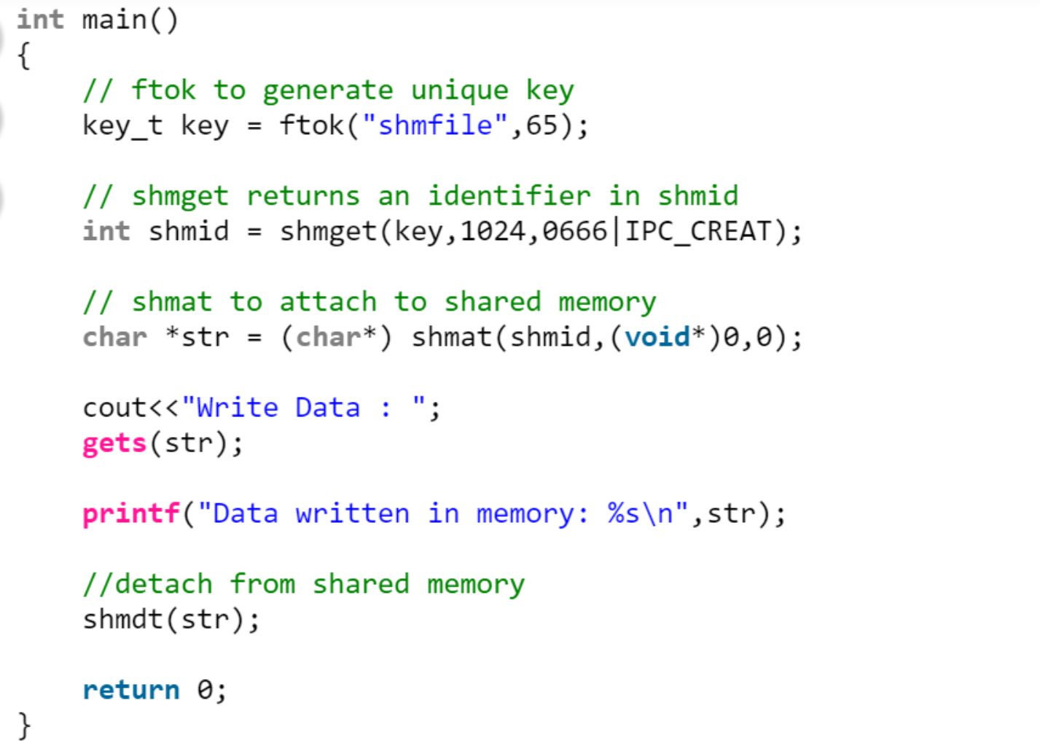
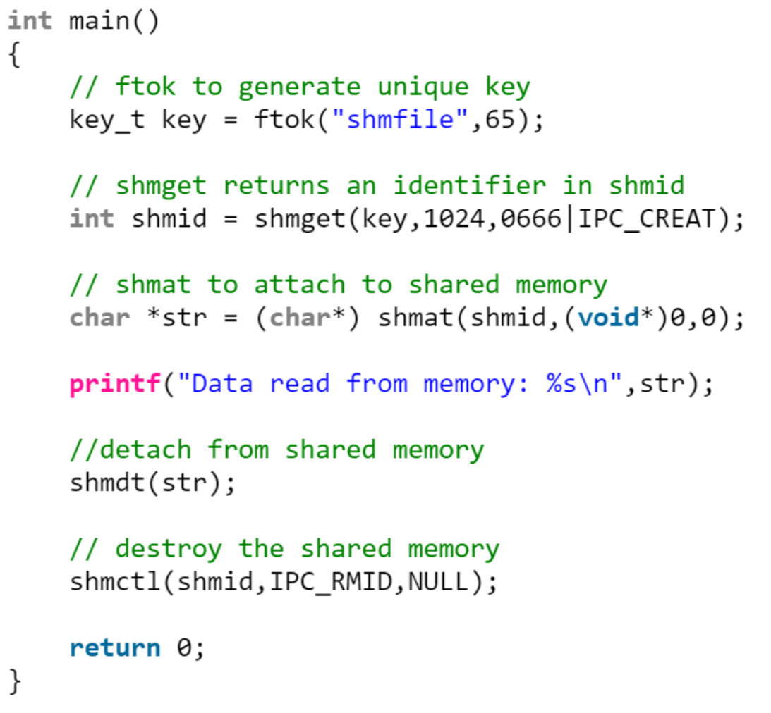
Ex 6: Can you design a diagram to illustrate the shared memory mechanism?

Slide 17
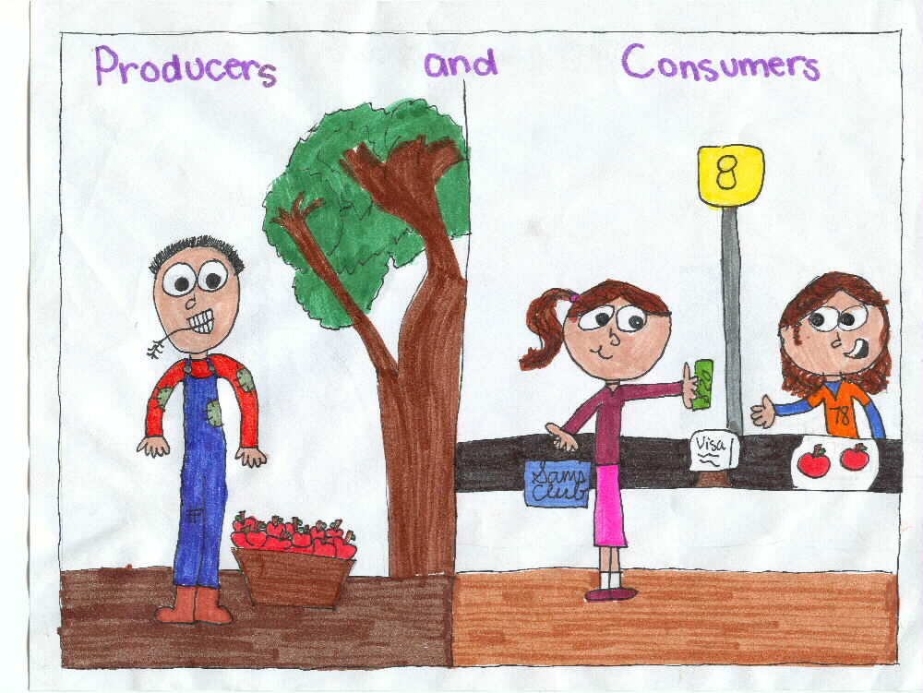
A Case Study: The Producer-Consumer Problem
A producer process produces information that is consumed by a consumer process:
unbounded-buffer places no practical limit on the size of the buffer
bounded-buffer assumes that there is a fixed buffer size
Picture courtesy of www.niu.edu
Notes:
Which one is more practical?

Slide 18
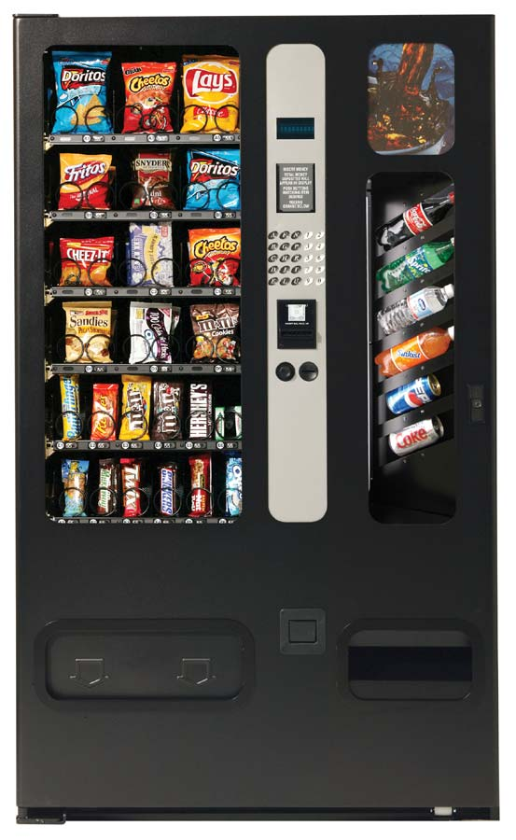



An Example: the soda machine
Soda drinker
(consumer)
Delivery person
(producer)
Vending machine
(buffer)
Is this an unbounded buffer or bounded one?
Slide courtesy of Dr. Jeff Chase at Duke University
Notes:
Principles of Concurrency
Interleaving and overlapping
can be viewed as examples of concurrent processing
both present the same problems
Uniprocessor – the relative speed of execution of processes cannot be predicted
depends on activities of other processes
the way the OS handles interrupts
scheduling policies of the OS
At first glance, it may seem that interleaving and overlapping represent fundamentally different modes of execution and present different problems. In fact, both techniques can be viewed as examples of concurrent processing, and both present the same problems. In the case of a uniprocessor, the problems stem from a basic characteristic of multiprogramming systems: The relative speed of execution of processes cannot be predicted. It depends on the activities of other processes, the way in which the OS handles interrupts, and the scheduling policies of the OS.
The following difficulties arise:
1. The sharing of global resources is fraught with peril. For example, if two processes both make use of the same global variable and both perform reads and writes on that variable, then the order in which the various reads and writes are executed is critical. An example of this problem is shown in the following subsection.
2. It is difficult for the OS to manage the allocation of resources optimally. For example, process A may request use of, and be granted control of, a particular I/O channel and then be suspended before using that channel. It may be undesirable for the OS simply to lock the channel and prevent its use by other processes; indeed this may lead to a deadlock condition, as described in Chapter 6 .
3. It becomes very difficult to locate a programming error because results are typically not deterministic and reproducible (e.g., see [LEBL87, CARR89, SHEN02] for a discussion of this point).
All of the foregoing difficulties present themselves in a multiprocessor system as well, because here too the relative speed of execution of processes is unpredictable. A multiprocessor system must also deal with problems arising from the simultaneous execution of multiple processes. Fundamentally, however, the problems are the same as those for uniprocessor systems. This should become clear as the discussion proceeds.

Slide 19
Bounded-Buffer – Shared-Memory Solution
#define BUFFER_SIZE 10
typedef struct {
. . .
} item;
item buffer[BUFFER_SIZE];
int in = 0;
int out = 0;
Shared Data
Data structure is correct.
Can only use BUFFER_SIZE-1 elements

Slide 20
Exercise 6: Please complete the following code for the producer process.
item next_produced;
while (true) {
/* produce an item in next produced */
while (((in + 1) % BUFFER_SIZE) == out )
; /* do nothing */
buffer[in] = next_produced;
in = (in + 1) % BUFFER_SIZE;
}
Buffer is full
Go to the next empty buffer slot

Slide 21
Exercise 7: Please complete the following code for the consumer process.
item next_consumed;
while (true) { while (in == out )
; /* do nothing */ next_consumed = buffer[out];
out = (out + 1) % BUFFER_SIZE;
/* consume the item in next consumed */
}
Buffer is empty
Go to the next buffer slot

Slide 22
Exercise 8 (Menti): What issue hasn’t been addressed in the above producer-consumer solution?
No issue. It is a perfect solution.
There a debugging problem
There is a synchronization problem
There is a user-space problem

Slide 23

Summary: IPC Model - Shared Memory
An area of memory shared among the processes that wish to communicate
The communication is under the control of the users processes not the operating system.
Major issues: To synchronize actions when shared memory are accessed.
Synchronization is discussed in great details in COMP3500.
Notes:
An area of memory shared among the processes that wish to communicate
The communication is under the control of the users processes not the operating system.
Major issues: provide mechanism allowing user processes to synchronize their actions when they access shared memory.
Synchronization is discussed in great details in COMP3500.

